Slide 1


SCTP JDE04
Project presentation
Tech Titan
Vinoth, Ernest, Ara, Anjali

Slide 2

Problem Statement
As climate change continues to plague the Earth (World Economic Forum, 2024), it is important to study the economic and environmental aspects of the current Sustainability landscape.

Slide 3
To do so, we embarked on an exploratory data analysis (EDA) with sources extracted through ETL data pipeline

Slide 4
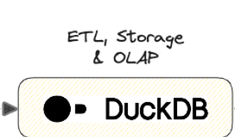





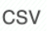
Data ingestion from various source formats
Data source

Slide 5



Contents
Load
Extract
Findings
Transform

Slide 6

01/Extract
Looking at the available datasets, eventually settled on Sustainability as topic
Kaggle API to download dataset
!pip install kaggle
import os [requires kaggle username and kaggle key]
import kaggle
kaggle.api.dataset_download_files('anshtanwar/global-data-on-sustainable-energy', path='./data', unzip=True)

Slide 7
02/
Transform
Cleaned and wrangled with data

Slide 8

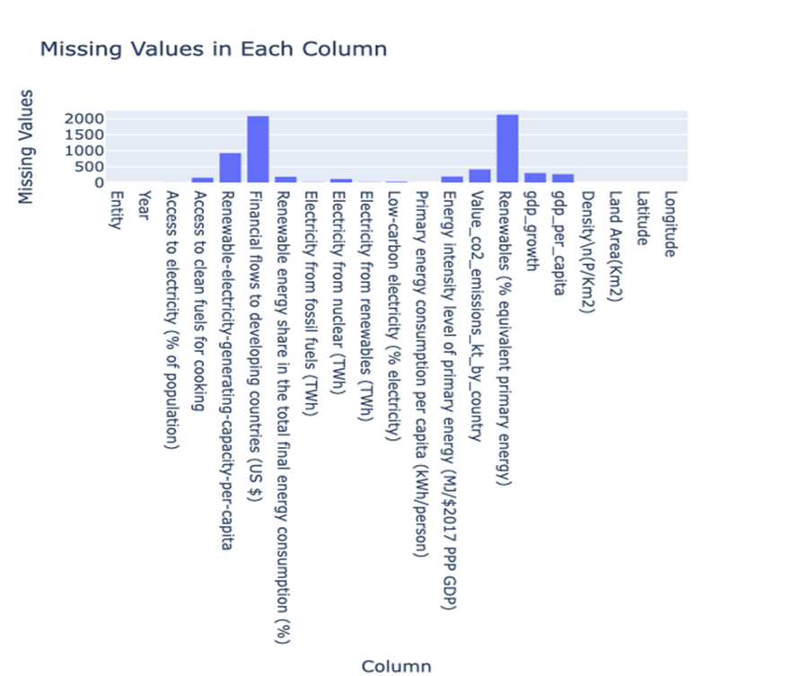
02/
Transform: Data normalization
Merged columns from another source
Dropped unnecessary columns
Pandas dataFrame creation
Mean Imputation method
Further clean by filling missing values with 0
isna.sum() to check for missing values

Slide 9
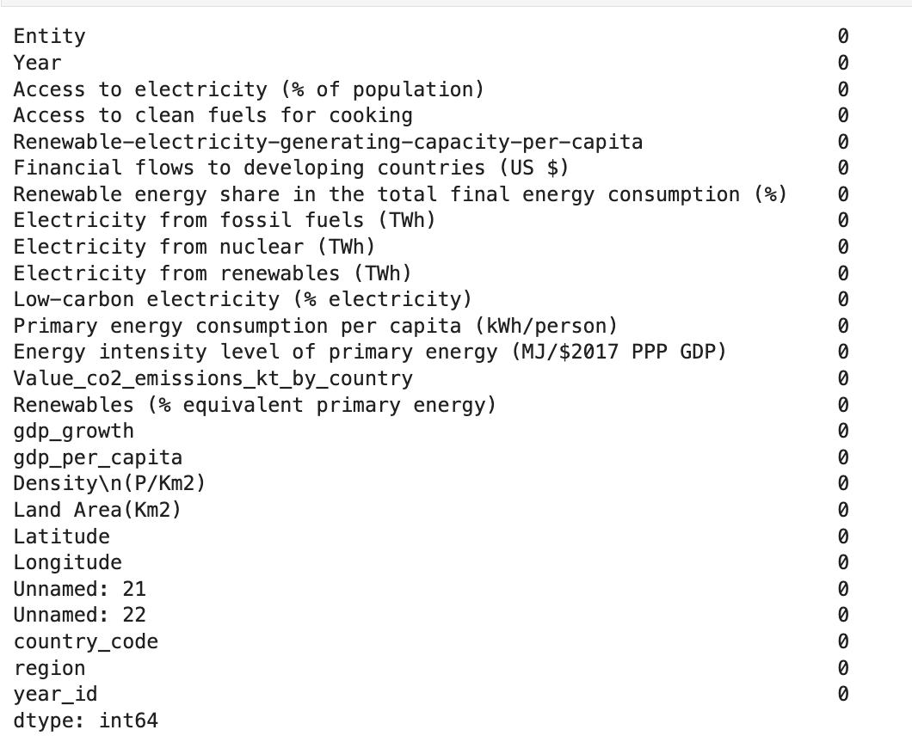
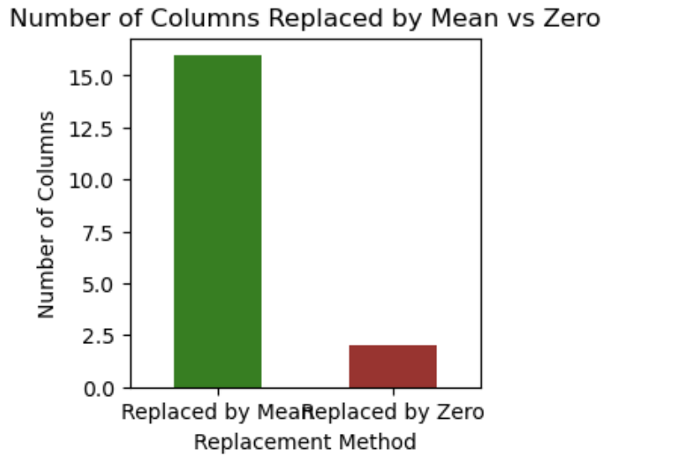
02/
Transform: Data normalization
Used Pandas data-frame to read our data file.
Used Python to do the data cleaning by –
Dropping duplicate countries records
Map each country with respective country code
Identifying the columns with missing values, used mean imputation method to impute mean value in NaN fields.
However, excluded two columns -Financial flows to developing countries (US $) and Renewables (% equivalent primary energy) because the values in these columns are NaN only for developed countries that do not receive financial aid

Slide 10
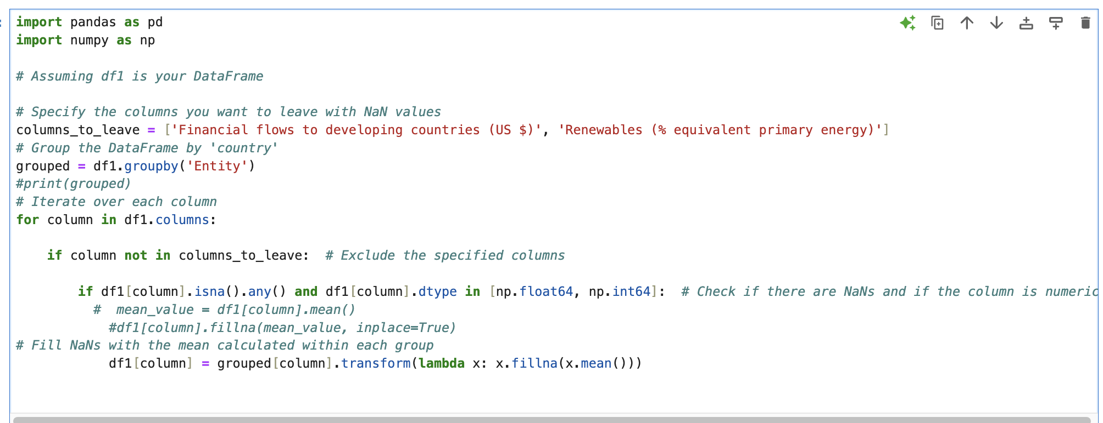
Code Snippet – Impute Null Values

Slide 11
03/
Load
Used DuckDB to create a Database

Slide 12
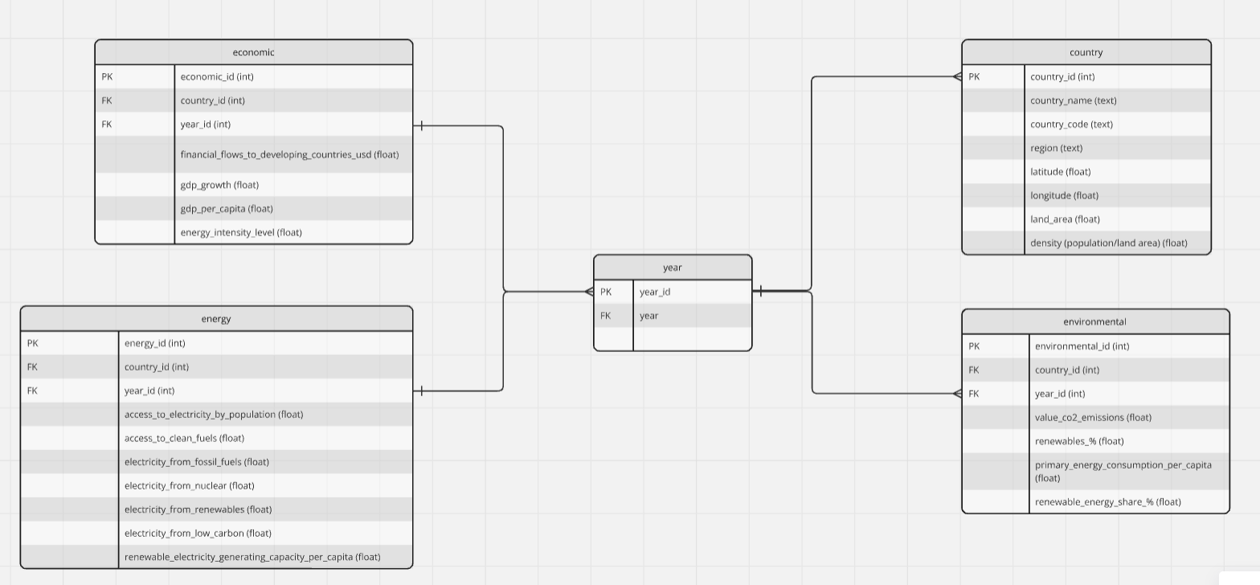
Entity Relationship Diagram

Slide 13
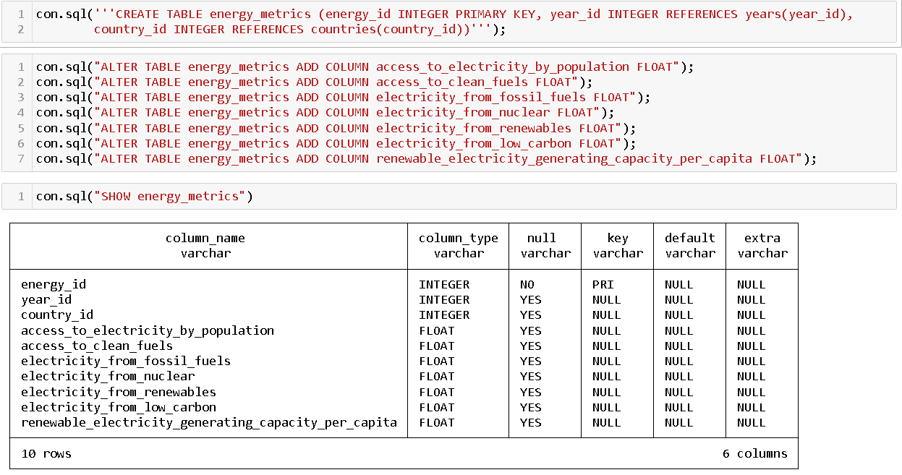
DB & Table Creation, Adding Constraints

Slide 14
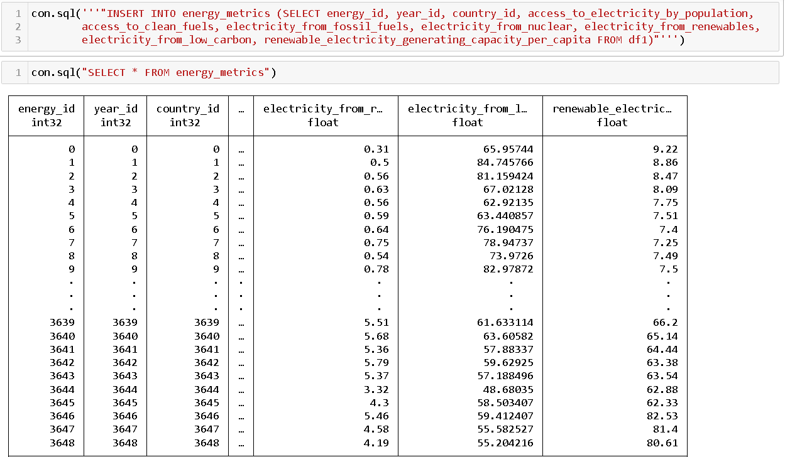
Insertion of data into energy_metrics table,
Querying all rows from energy_metrics table

Slide 15
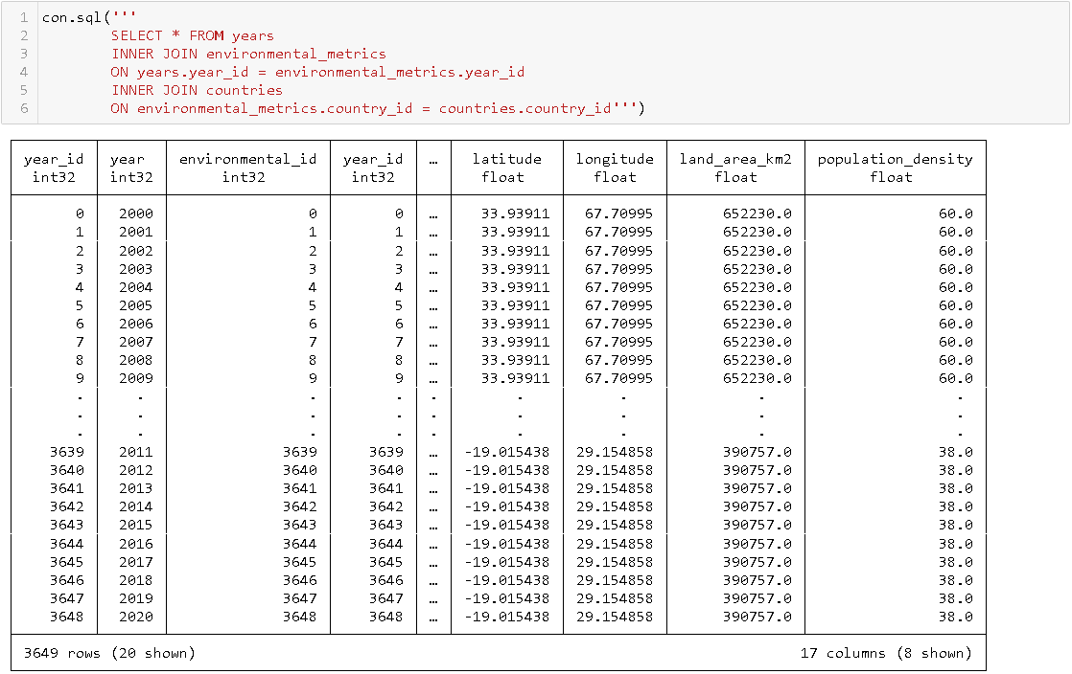
Performing inner joins between years, environmental_metrics & countries tables

Slide 16


Why DuckDB
03/
Load
Comparison of DuckDB and PostgreSQL
Feature/Aspect | PostgreSQL | DuckDB
Storage Format | Row-based storage | Columnar storage with dictionary compression
Concurrency Control | Combination of locks, isolation levels, and transaction serialization | Optimistic multiversion concurrency control (MVCC)
SQL Features | Broad range of SQL features, suitable for complex transaction processing and large-scale applications | Subset of SQL features optimized for analytical workloads
Data Durability | Emphasizes data durability with all committed changes flushed to disk | Prioritizes in-memory performance, may not flush data to disk immediately
Extensibility | Extensive ecosystem with various extensions and plugins | Limited ecosystem, fewer extensions available
Community and Adoption | Large, established community with extensive documentation and support | Smaller, newer community with growing adoption
Use Cases | Web applications, geospatial data, business intelligence, analytics, content management systems, financial applications, scientific applications | Embedded analytics, data science, data processing, ETL pipelines
Scalability | Supports vertical scaling, horizontal scaling through partitioning, sharding, and replication | Focused on single-node performance, limited support for parallelism
Why DuckDB over PostgreSQL
Feature/Aspect | DuckDB | PostgreSQL
Performance | Optimized for analytical queries with columnar storage and vectorized query execution, making it extremely fast for data analysis tasks | General-purpose performance, suitable for both transactional and analytical workloads
Ease of Use | Simple installation with no external dependencies, making it easy to set up and use | Requires more setup and configuration, especially for advanced features
In-Process Execution | Runs within the application process, reducing overhead and improving performance for embedded analytics | Runs as a separate server process, which can introduce additional overhead
Resource Efficiency | Designed to be lightweight and efficient, suitable for environments with limited resources | More resource-intensive, especially for large-scale deployments
Data Analysis | Specifically optimized for OLAP (Online Analytical Processing) workloads, making it ideal for data science and analytics | Supports both OLAP and OLTP (Online Transaction Processing) workloads, but not as specialized for analytics
Integration | Easily integrates with data science tools like Python and R, enhancing its utility for data analysis | Broad integration capabilities, but may require additional configuration for seamless use with data science tools

Slide 17
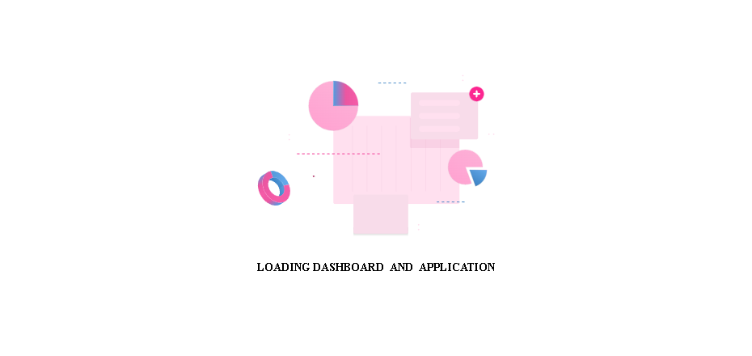
Windows add-in : Vizslides

Slide 18
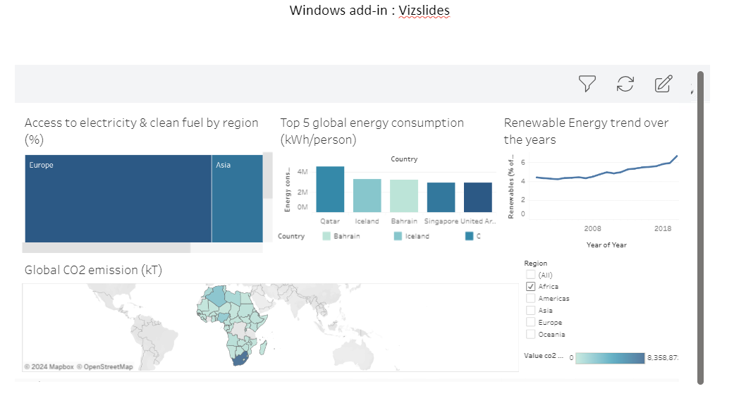

Slide 19
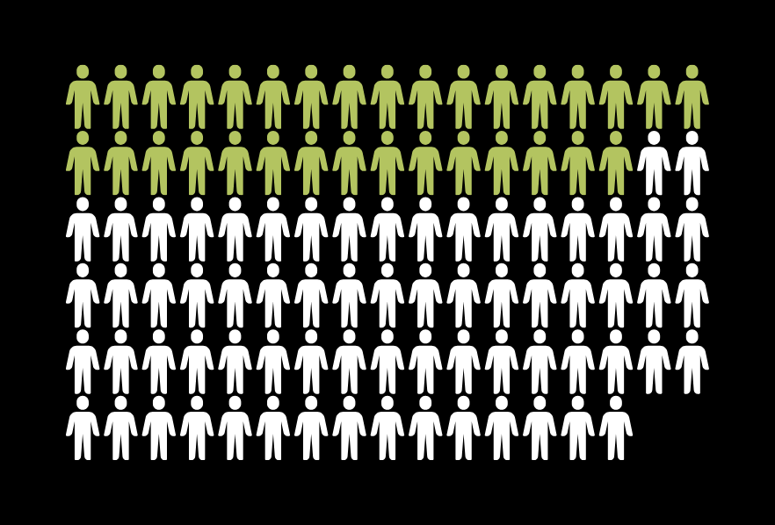

04/
Findings
https://public.tableau.com/views/GlobalSustainability_17244000995580/JDEinterimproject?:language=en-US&:sid=&:redirect=auth&:display_count=n&:origin=viz_share_link

Slide 20
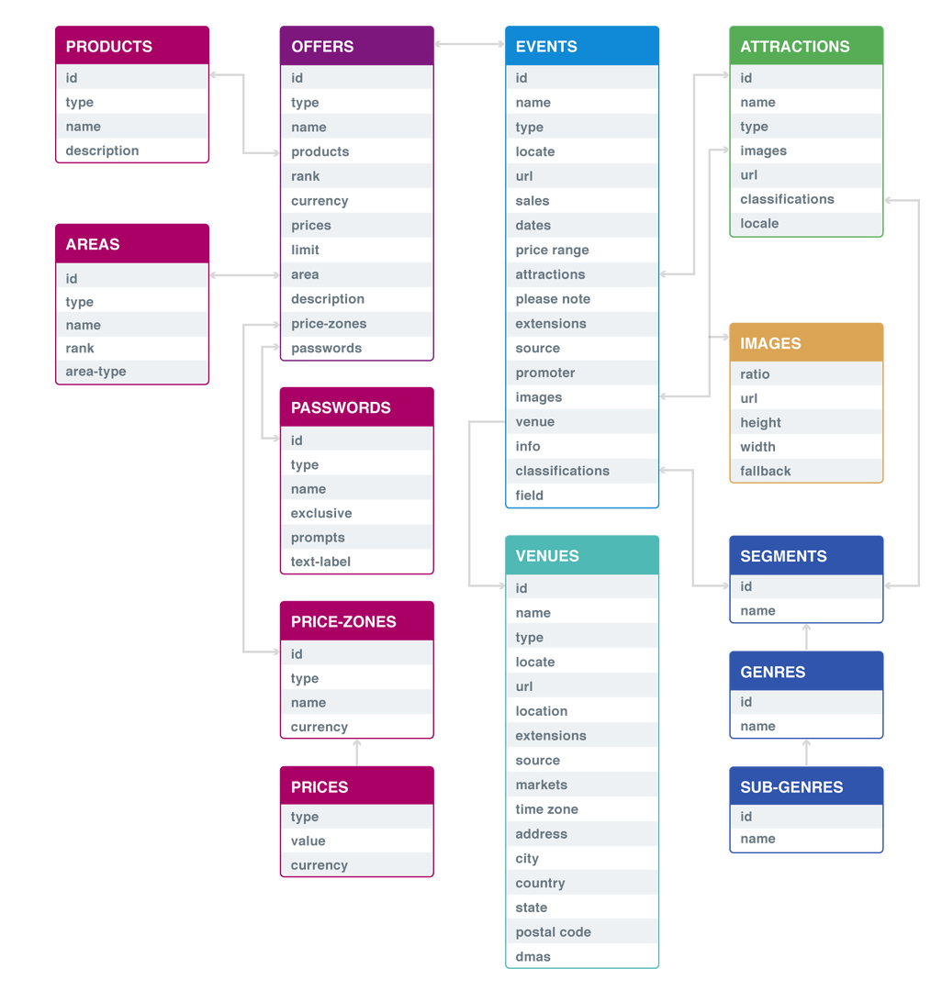
Challenges: 01/Extract
Initial Objective:
Study the purchasing trends on Ticketmaster platform
Ticketmaster API
However, too many layers to unpack
2. Used Apify web scraper:
Data extraction, as JSON file
While promising, eventually found out it contain data for events only

Slide 21
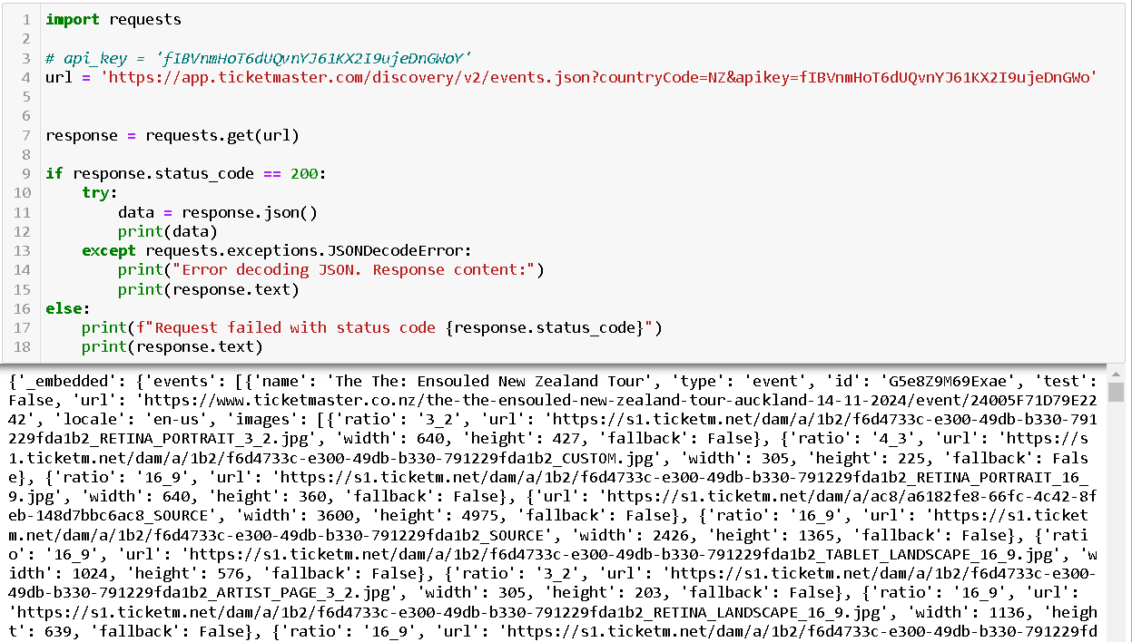
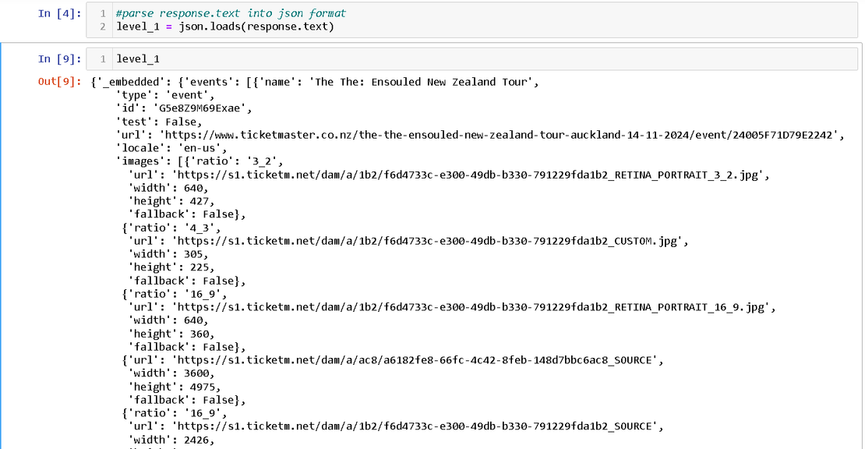
Challenges: 01/Extract
1st layer of raw data extracted using requests.
Parsing the data into json format for readability

Slide 22
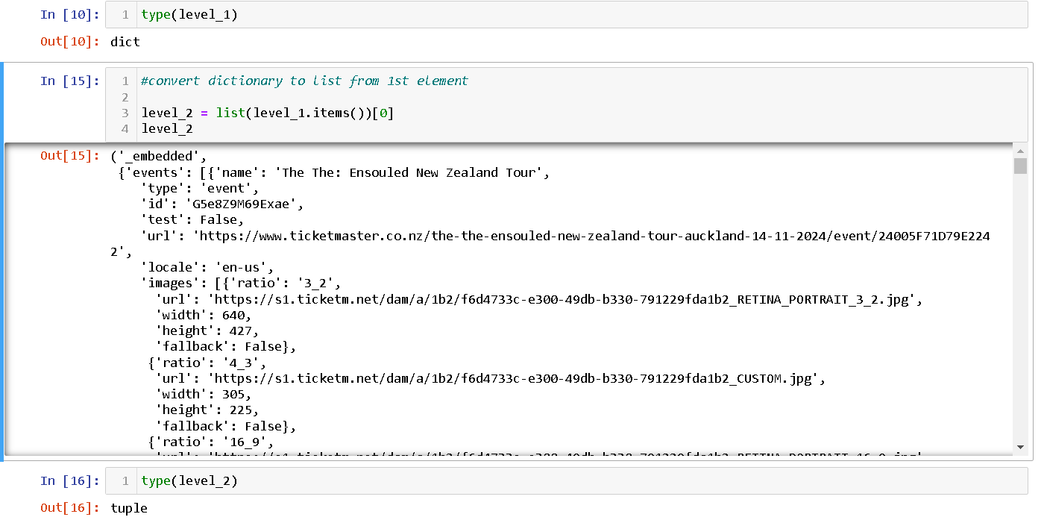
Challenges: 01/Extract
Identifying the data type where the data is stored in.

Slide 23
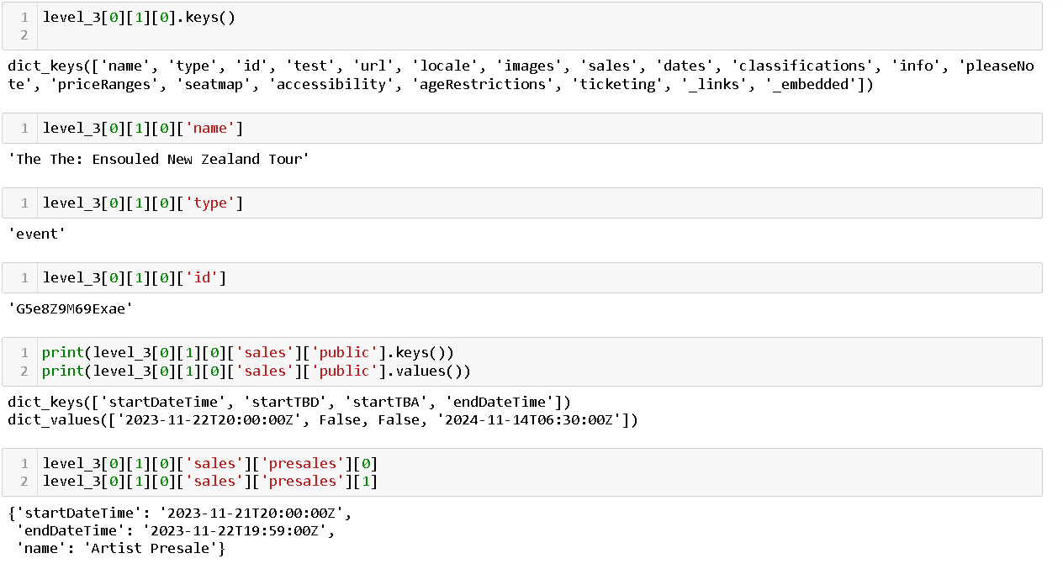
Challenges: 01/Extract
After identifying the different elements and keys, eventually getting to the data needed.

Slide 24
SCTP JDE04
References:
Periods of extreme heat are becoming more common - this is what you need to know. (2024, August 21). World Economic Forum. https://www.weforum.org/agenda/2024/08/extreme-heat-climate-change/

